Slide 1
RTX-Explore
DXR Path Tracer
Liam Dugan · Henry Zhu · Ziad Ben Hadj-Alouane

Slide 2
Current Progress

Slide 3
MILESTONE II - Part 1
Path Tracing Pipeline

Slide 4
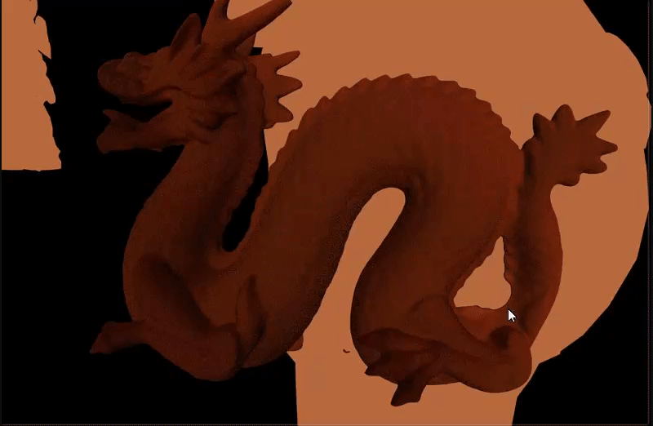

Slide 5
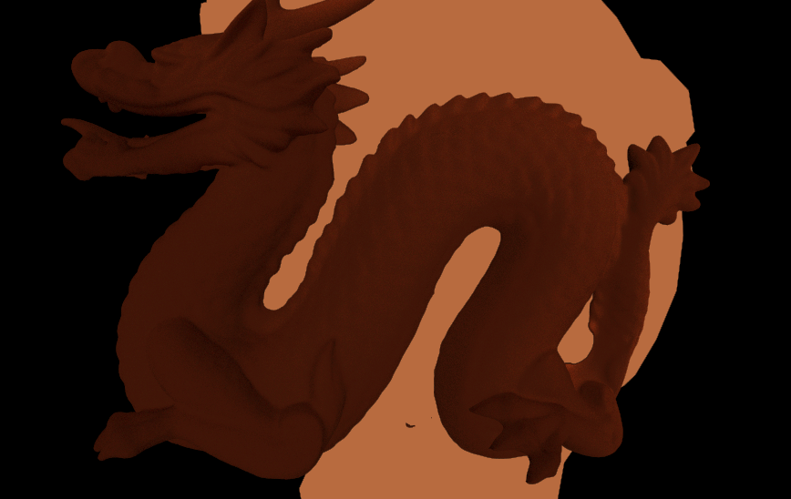

Slide 6


Slide 7
MILESTONE II - Part 2
Diffuse, Reflective, Refractive, Fresnel, Schlick

Slide 8


Slide 9
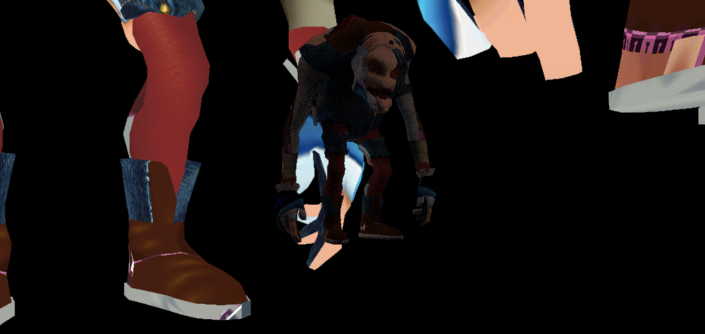

Slide 10
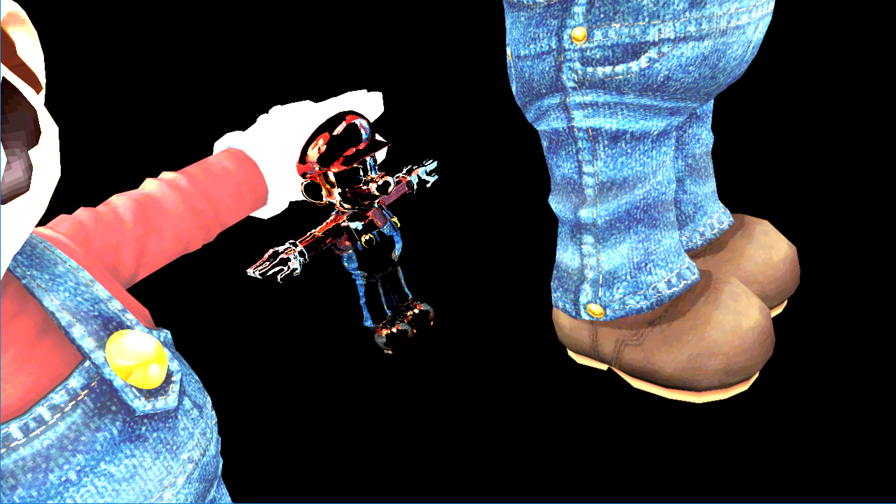

Slide 11
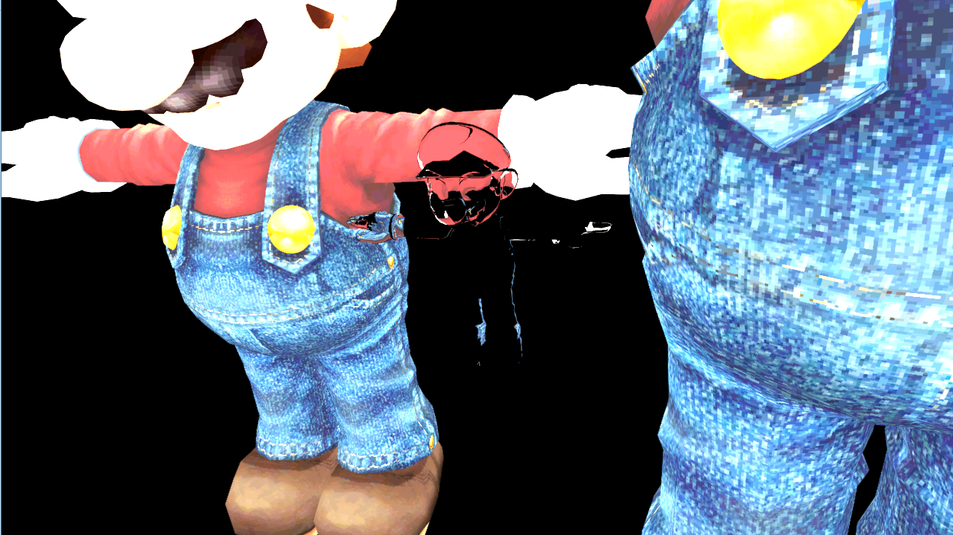

Slide 12
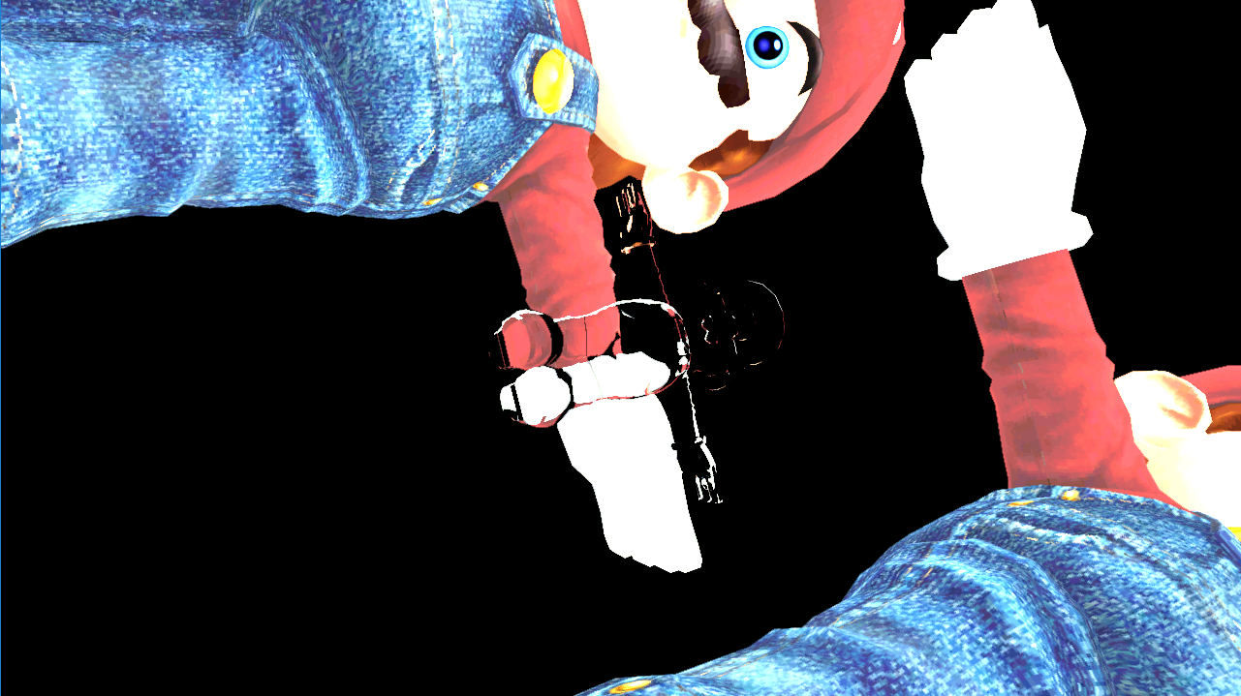

Slide 13
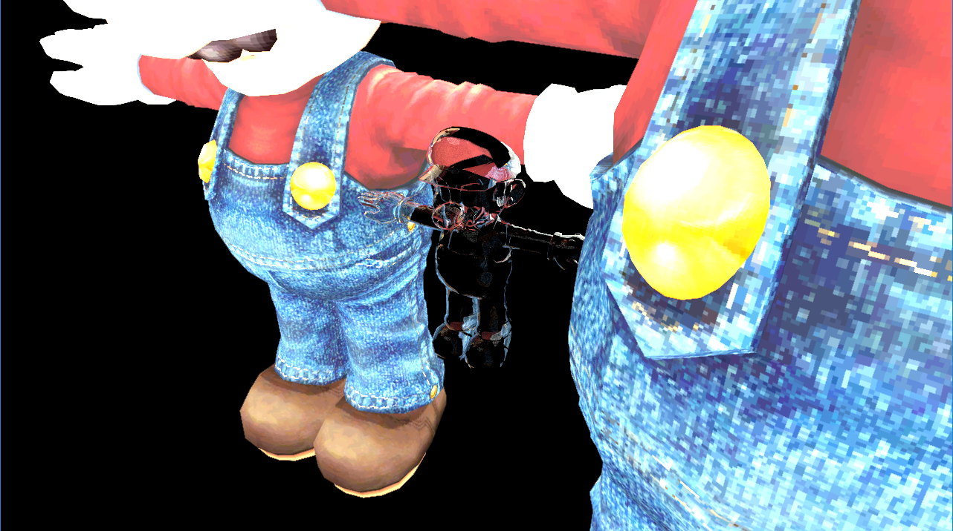

Slide 14
MILESTONE I - Part 3
Scene Loading (multiple objects, multiple materials, multiple textures)

Slide 15
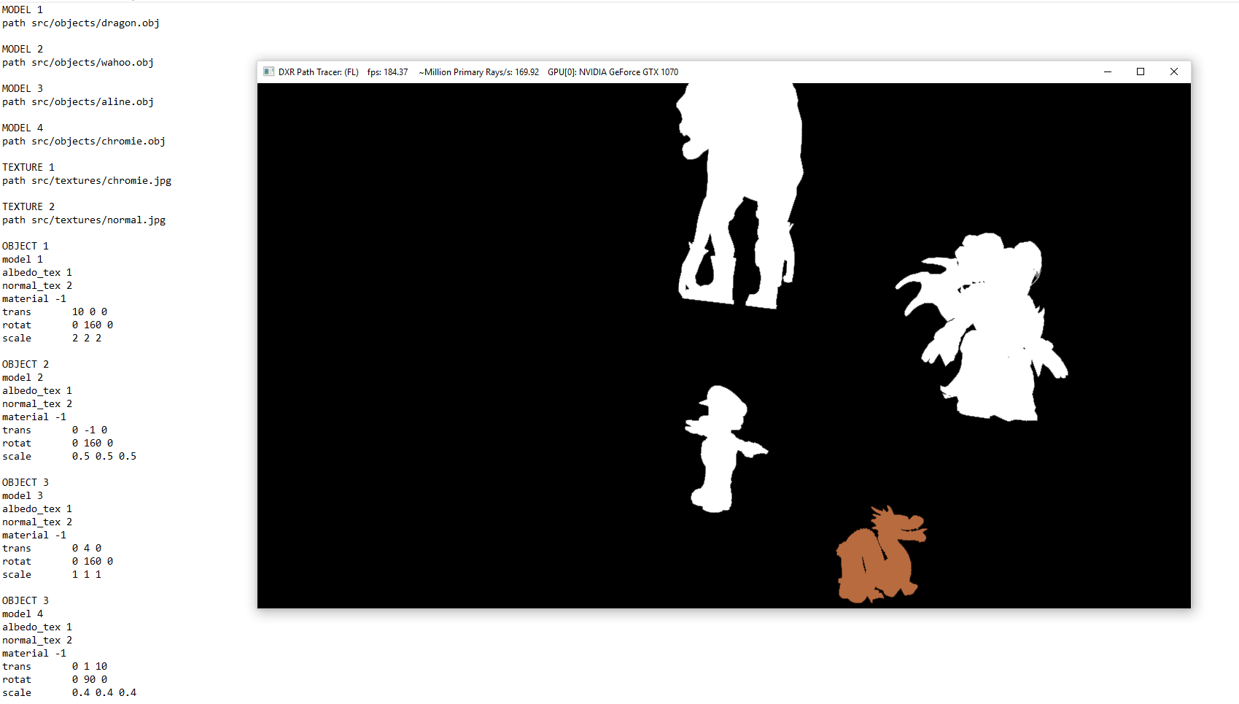

Slide 16
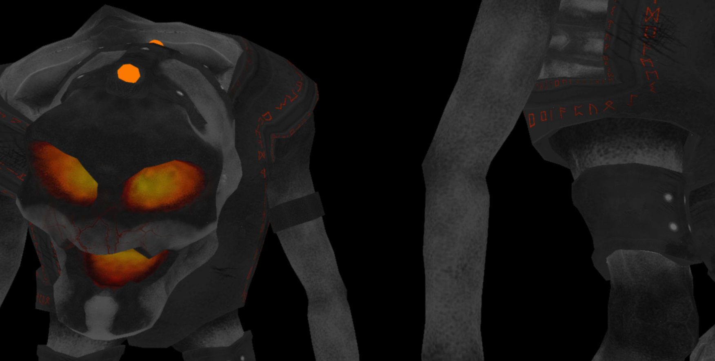

Slide 17
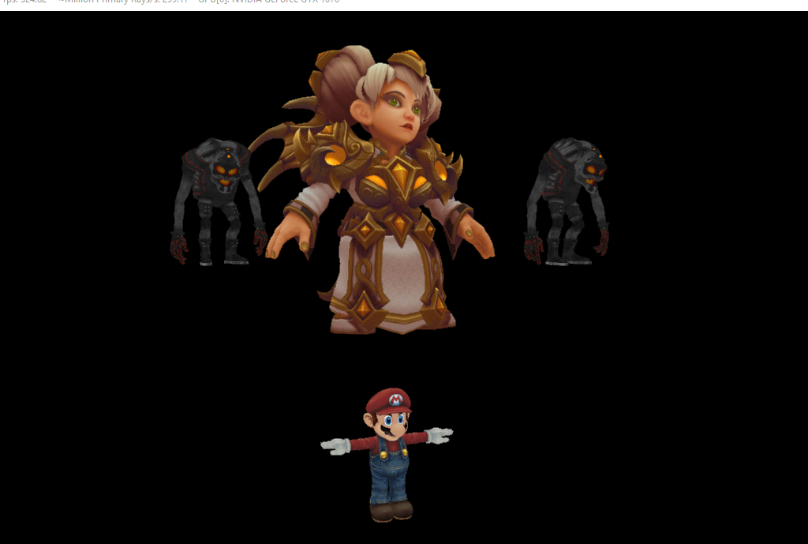

Slide 18
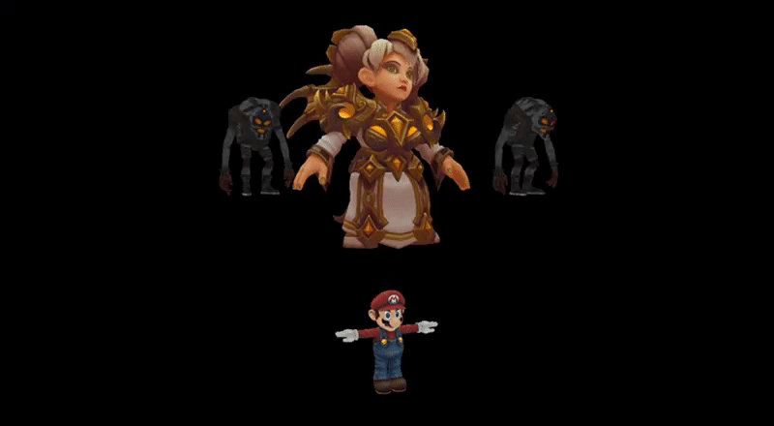

Slide 19
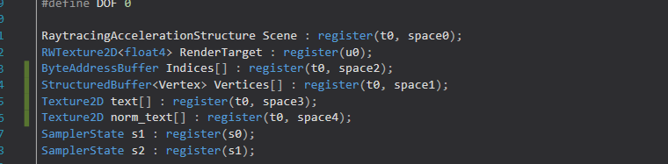
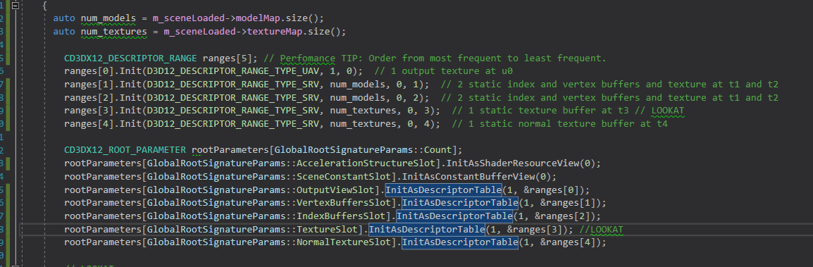

Slide 20
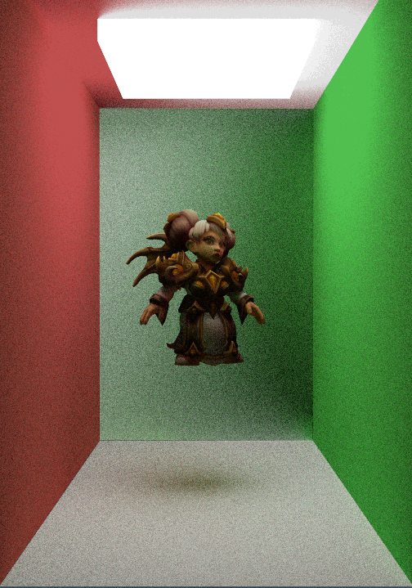

Slide 21
Upcoming Goals

Slide 22
MILESTONE III
Fresnel & Schlick (done)
Dispersion
Subsurface scattering
Finish scene loading
Another application of raytracing (?)

